Slide 1
Emissivity and Temperature Retrieval: From Theory to Python Workflow
Aliyya Rinu
Junior Research Fellow
National Institute of Science Education and Research

Slide 2
Naïve Representation of an Inverse Problem
Forward Modeling
Spectral Radiance
(Reflectance component + Emission component)
Observed Spectra
Synthetic Spectra
Update the unknown parameters
no
Match?
yes
stop

Slide 3
General statements on the problem like why thermal correction.
What’s the purpose of whole pipeline.

Slide 4

Introduction
Problem Statement
We aim to retrieve the values of physical parameters in the model using only the observed, noisy spectral radiance from spacecraft data.
we get a system of equation to solve for the unknown values. Seems fine. But There are challenges:
The model is non-linear
The system is underdetermined: more unknowns than data points
Possible null space → multiple solutions
The wavelength region includes both:
Reflectance component, which is coupled to emission through emissivity
Thermal emission, which depends on emissivity and temperature
Therefore, both components must be modeled accurately to constrain T and e(λ) reliably.

Slide 5

Linear Inverse Problems and Least Square
Consider a Linear Model:
D = Gm ; D : Observed Data
G : Forward model
m : model parameters to be retrieved
When there is noise or the system is inconsistent, we define an error vector: e=D−Gm
We minimize the L2 norm (least squares loss):
Least Squares Solution
Set derivative to zero

Slide 6
But what if the problem is underdetermined?
When G is not full-rank or when there are more unknowns than data, we can't invert G^{T}G directly.
There are infinitely many possible solutions.
x
Forward Model
y
State Space
Measurement Space

Slide 7
How do we fix this? -We introduce additional constraints to reduce the solution space
Adding a priori information introduces an additional term in our norm, incorporating constraints that guide the solution.
This error minimization in the presence of prior information can be naturally framed within a Bayesian framework — treating the solution as a probability distribution conditioned on both the observed data and prior knowledge.

Slide 8
Bayesian Framework for Inverse Problems
Provides a structured approach for finding solutions.
Uses observed data and associated measurement error statistics.
uses prior information to refine the solution space.
Narrows down the possible solutions from an infinite state space.

Slide 9
Posterior Distribution: Provides the conditional probability distribution over possible solution states.
Optimal State Selection: Choose the optimal state from the posterior distribution – the expected value of posterior or the maximum a priori state
Error Estimate: Report the error estimate using the second moment matrix.

Slide 10
Under the assumption of guassian error statistics for our observed data, i.e, prior for the parameters being guassian distribution. Also assuming that the parameters are indepentant and utilizing the bayes rule

Slide 11

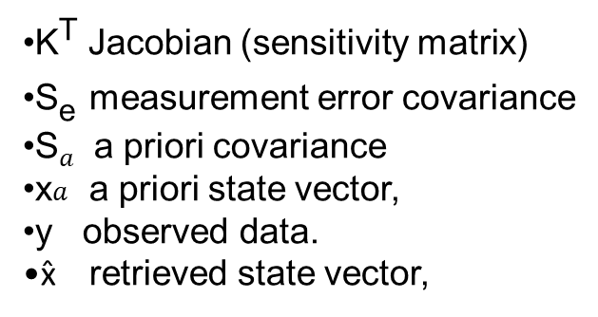
Meeting the least squares through bayes rule.
Maximum a posteriori solution- maximizing the posterior distribution.
K^{T} Jacobian (sensitivity matrix)
S_{e}​ measurement error covariance
S$a$​ a priori covariance
x$a$​ a priori state vector,
y observed data.
x̂ retrieved state vector,

Slide 12


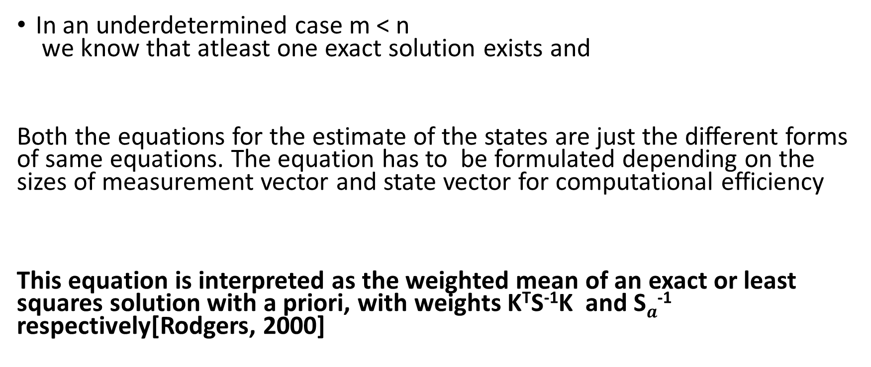
In an underdetermined case m < n we know that atleast one exact solution exists and
Both the equations for the estimate of the states are just the different forms of same equations. The equation has to be formulated depending on the sizes of measurement vector and state vector for computational efficiency
This equation is interpreted as the weighted mean of an exact or least squares solution with a priori, with weights K^{T}S⁻¹K and S$a$⁻¹ respectively[Rodgers, 2000]

Slide 13
What’s So Special About the Gaussian?
Note that the above Formulas which our life easy were derived under the assumption that errors in the measurement follows a guassian distribution.
The map solution and the expected solutions are the same givning us the optimal solution

Slide 14
NON LINEAR PROBLEM
For non-linear forward models, explicit solutions are generally not feasible—requiring iterative numerical methods instead, unlike in the linear case

Slide 15
Zooming Out for a Moment
Everything we’ve discussed so far sits nicely under the roof of linear problems.
But in our case, the forward model isn’t linear — it’s a radiative transfer equation!
This means the cost function, even with a Gaussian prior, won’t generally be quadratic in the state vector. So, the resulting derivative equations aren’t linear either.
But no worries — everything we derived for the linear Gaussian case can be extended to the non-linear world. Of course, it requires a few adjustments and approximations, but it still works — as long as we account for and report the uncertainties introduced by these approximations.
The standard approach is to linearize the forward model around a reference state vector, and then solve for the state iteratively using numerical techniques.

Slide 16
UNCIRTAINITIES AND THEIR ESTIMATION
This part needs more detailed explanation, updating sooon……….

Slide 17
DIAGONOSTICS
The Averaging Kernel represents the sensitivity of the retrieved state to the true state x
A = GK where G is the gain matrix and K is the Jacobian.
Why A matters:
Each row of A: shows how the true state influences the corresponding retrieved parameter — it's a mapping into the retrieval space.
The width of each kernel (row of A) indicates the retrieval resolution.
The area under each kernel is a measure of retrieval quality:
Values close to 1 mean most of the retrieval comes from the observed signal.
Values closer to 0 imply heavier reliance on the a priori — i.e., weaker constraint by the data.
DOF
Reading on this, need for clarifications

Slide 18
Formal Connection: Information Content & Averaging Kernel
The error in the retrieval on each state vectors is given by the square root value of the diagonal elements of the error covariance matrix. We an compare these values with corresponding a priori errors.
½ log_2|I-A|
The information content of the measurement,can be expressed as:

Slide 19
Having covered the mathematical foundations, let's now build a Python workflow to solve for emissivity and temperature.

Slide 20
Step 1
a priori values for temperature and emissivities along with the a priori error covariance matrix
Wavelength range(4.0 – 5.0 micrometers)
A priori values for the state vector
Few representative spectra chosen by clustering the data set.
MCMC chains are run to retrieve both spectral emissivities and temperature simultaneously in a spectral range where the thermal emission is predominant. Not keeping any parameter value constant for retrieving the other. Avoiding the errors due to constant value assumptions
S_a – the prior covariance matrix is a (n x n) diagonal matrix of size which remains the same through out the retrieval process.
Assumptions: clustering captures variations on our data set effectively.
Spectral variations in surface temperature is negligible
Every pixels are indepentant.

Slide 21
Prior & A Priori Matrix Context
Approaches tried so far for getting better Represenative spectra:
1. Mean Reflectance + Histogram Binning
Compute mean reflectance for each pixel, analyze histogram, and manually select samples from different bins.
Drawbacks:
Ignores spectral variation.
Dominant thermal regions can bias selection, leading to unrepresentative choices.
2. Clustering of Hyperspectral Data (Ongoing Work)
K-Means Clustering:
Treats each spectrum as a vector in high-dimensional space.
Groups similar spectra based on Euclidean distance.
GMM Clustering:
Probabilistic approach using Gaussian Mixture Models.
Drawback: Assumes Gaussian distribution of clusters, which might not hold for hyperspectral data.

Slide 22
The average temperature along with the variance is retained from the first retrieval.
Remarks : The error for the temperature is the variance from the samples of Markov chains

Slide 23
Step 2
Averaging over these ensemble of emissivities over the spectral range to be retrieved gives the prior values and the variance in each spectral emissivity.
10,000 samples of temperature drwn from N(T_avg, sigma).
Calculate the spectral emissivity using these ensemble of temperature values and the representative spectra.

Slide 24
Step 3
Note that the extreme wavelength region used for constructing the prior values and apriori covarince matrix is excluded in next retravel step to avoid any correlations in the observations and apriori. and could be retrieved after wards.

Slide 25
Step 4
We perform the optimal estimation using a levenberg-Marquardt scheme for numerically soving our set of equations as described detailed in the previous slides.
Remark: The hyperparameter gamma is tuned in each iteration(not necessarily) to ensure right convergence.

Slide 26
Step 5
We stop Iteration when the step size in either the y space or x space is smaller than the derived uncirtainities .
in y space:

Slide 27
Validation and improvements
Data Set 1 – Haulani crater at 9:00 am
Data Set 2 – Haulani crater at noon
Including forward model error, because we are not retrieving disk function which can induce unciratainities

